Slide 1
Driver Anti Sleep Device Project
Submitted by:

Slide 2
CONTENTS
Timer
Resistors
Capacitors
Logic Gates
Diode
Transistors
Relay
Buzzer
Switch

Slide 3
Project overview
The project is useful for night shift drivers and for long journey driver that alerts them when they fall asleep while driving. The project consists of a circuit that includes ultrasonic transmitter, receiver and a microcontroller. The transmitter continuously transmits 40 KHz signals towards the staring wheel and these signals get reflected over to the ultrasonic receiver. The circuit tracks the time required for ultrasonic waves to get reflected from and received and this is used for determining the distance between the circuit and the staring wheel. If the driver sleeps then his head will get inclined towards staring wheel and this reduces the time needed for receiver to receive the reflected signals. Thus the circuit comes to know that the driver has slept and the microcontroller will immediately sound the buzzer so that it awakes driver. Hence the system can avoid accidents and provide safety for both the passengers and driver.

Slide 4
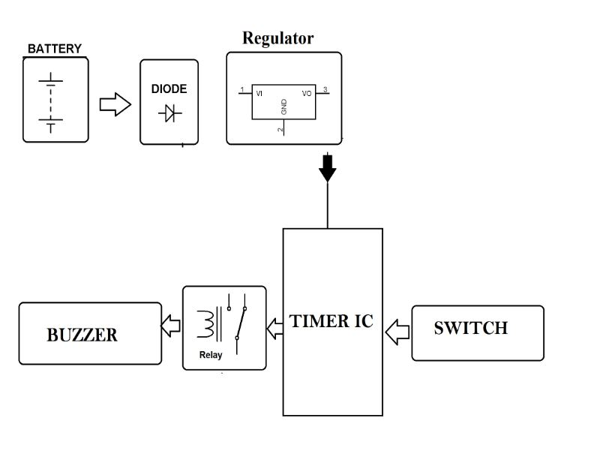
Block diagram

Slide 5

RELAY
A relay is an electrically operated switch. Many relays use an electromagnet to operate a switching mechanism mechanically, but other operating principles are also used. Relays are used where it is necessary to control a circuit by a low-power signal (with complete electrical isolation between control and controlled circuits), or where several circuits must be controlled by one signal.

Slide 6
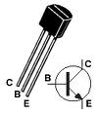
BC547
The BC547 transistor is an NPN Epitaxial Silicon Transistor.
The BC547 transistor is a general-purpose transistor in small plastic packages.
It is used in general-purpose switching and amplification BC847/BC547 series 45 V, 100 mA NPN general-purpose transistors.
Whenever base is high, then current starts flowing through base and emitter and after that only current will pass from collector to emitter

Slide 7
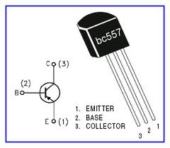
BC557
The BC557 transistor is an PNP Epitaxial Silicon Transistor
The BC557 transistor is a general-purpose transistor in small plastic packages. It is used in general-purpose switching and amplification BC847/BC547 series 45 V, 100 mA PNP general-purpose transistors.

Slide 8
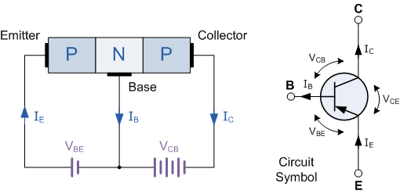
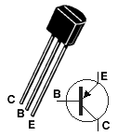
The arrow in the PNP transistor symbol is on the emitter leg and points in the direction of the conventional current flow when the device is in forward active mode.

Slide 9


